Slide 1

The Future of Native App Development in .NET 6
David Ortinau | Program Manager | @davidortinau
Maddy Leger |Program Manager | @maddyleger1

Slide 2












iOS
macOS

Slide 3








Swift
Swift
JS
JS
iOS
iOS
JS
Swift
JS
JS
Swift
JS
JS
Java
.NET
JS
Java
C++
Java
C++
JS
Obj-C
Kotlin
Obj-C
Java
Obj-C
macOS
Kotlin
Kotlin
Obj-C
Kotlin

Slide 4
iOS
iOS
macOS
.NET
.NET
.NET
.NET
.NET
.NET
.NET
.NET
.NET
.NET
.NET
.NET
.NET
.NET
.NET
.NET
.NET
.NET
.NET
.NET
.NET
.NET
.NET
.NET
.NET
.NET
.NET
.NET
.NET
.NET
.NET
.NET
.NET
.NET
.NET
.NET
.NET
.NET
.NET
.NET
.NET
.NET
.NET
.NET
.NET

Slide 5
.NET Multi-platform App UI
.NET 6
Cross-platform, native UI
Single project system, single codebase
Deploy to multiple devices, mobile & desktop
General availability in .NET 6
.NET Multi-platform App UI
WinUI
Mac Catalyst
iOS
Android
macOS
iOS
github.com/dotnet/maui

Slide 6
.NET Multi-platform App UI is the evolution of Xamarin.Forms extended from mobile to desktop scenarios with UI controls rebuilt from the ground up for performance and extensibility.

Slide 7
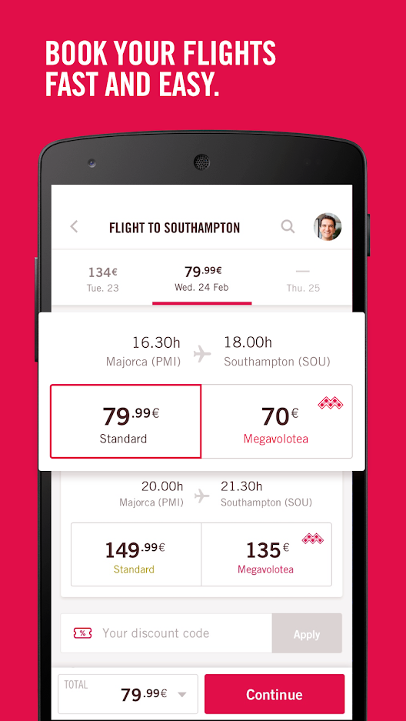
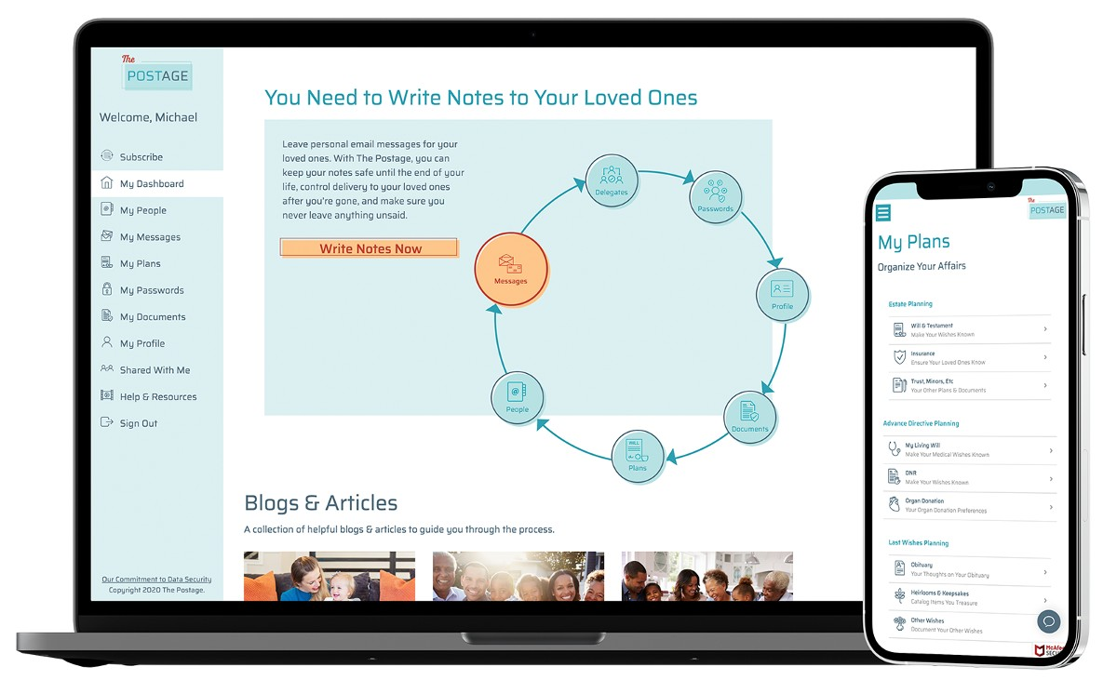
https://dotnet.microsoft.com/platform/customers

Slide 8
Pillars of Client App Development
.NET
Native User Interfaces
Native API Access
Native Performance

Slide 9
How is this native?
.NET Multi-platform App UI
.NET for Android
.NET for iOS / Mac Catalyst
WinUI
.NET BCL
App Code
.NET Runtime (Mono or CoreCLR)
Android
iOS
macOS
Windows

Slide 10
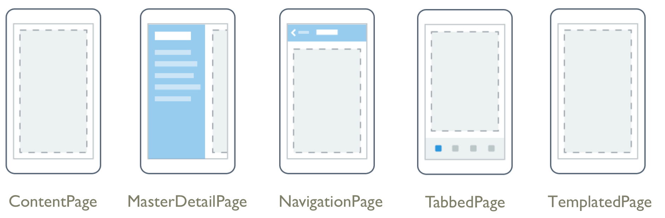
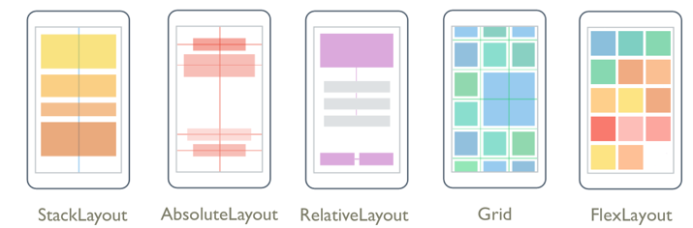
Layouts
Pages

Slide 11
Controls
CarouselView
CollectionView
RefreshView
IndicatorView
Checkbox
RadioButton
ImageButton
SwipeView
ActivityIndicator
BoxView
Button
DatePicker
Editor
Entry
Image
Label
ListView
Map
OpenGLView
Picker
ProgressBar
SearchBar
Slider
Stepper
TableView
TimePicker
WebView
EntryCell
ImageCell
SwitchCell
TextCell
ViewCell
Path
Ellipse
Polygon
Rectangle
Line
Polyline

Slide 12
Native UI
Elements are realized via platform handlers.
 | ContentPage | Label | Picker
Android | Activity / Fragment | TextView | AlertDialog + LinearLayout + EditText + NumberPicker
iOS/Mac | UIViewController | UILabel | UITextField + UIPickerView + UIToolbar + UIBarButtonItem
WinUI | Page | TextBlock | ComboBox

Slide 13
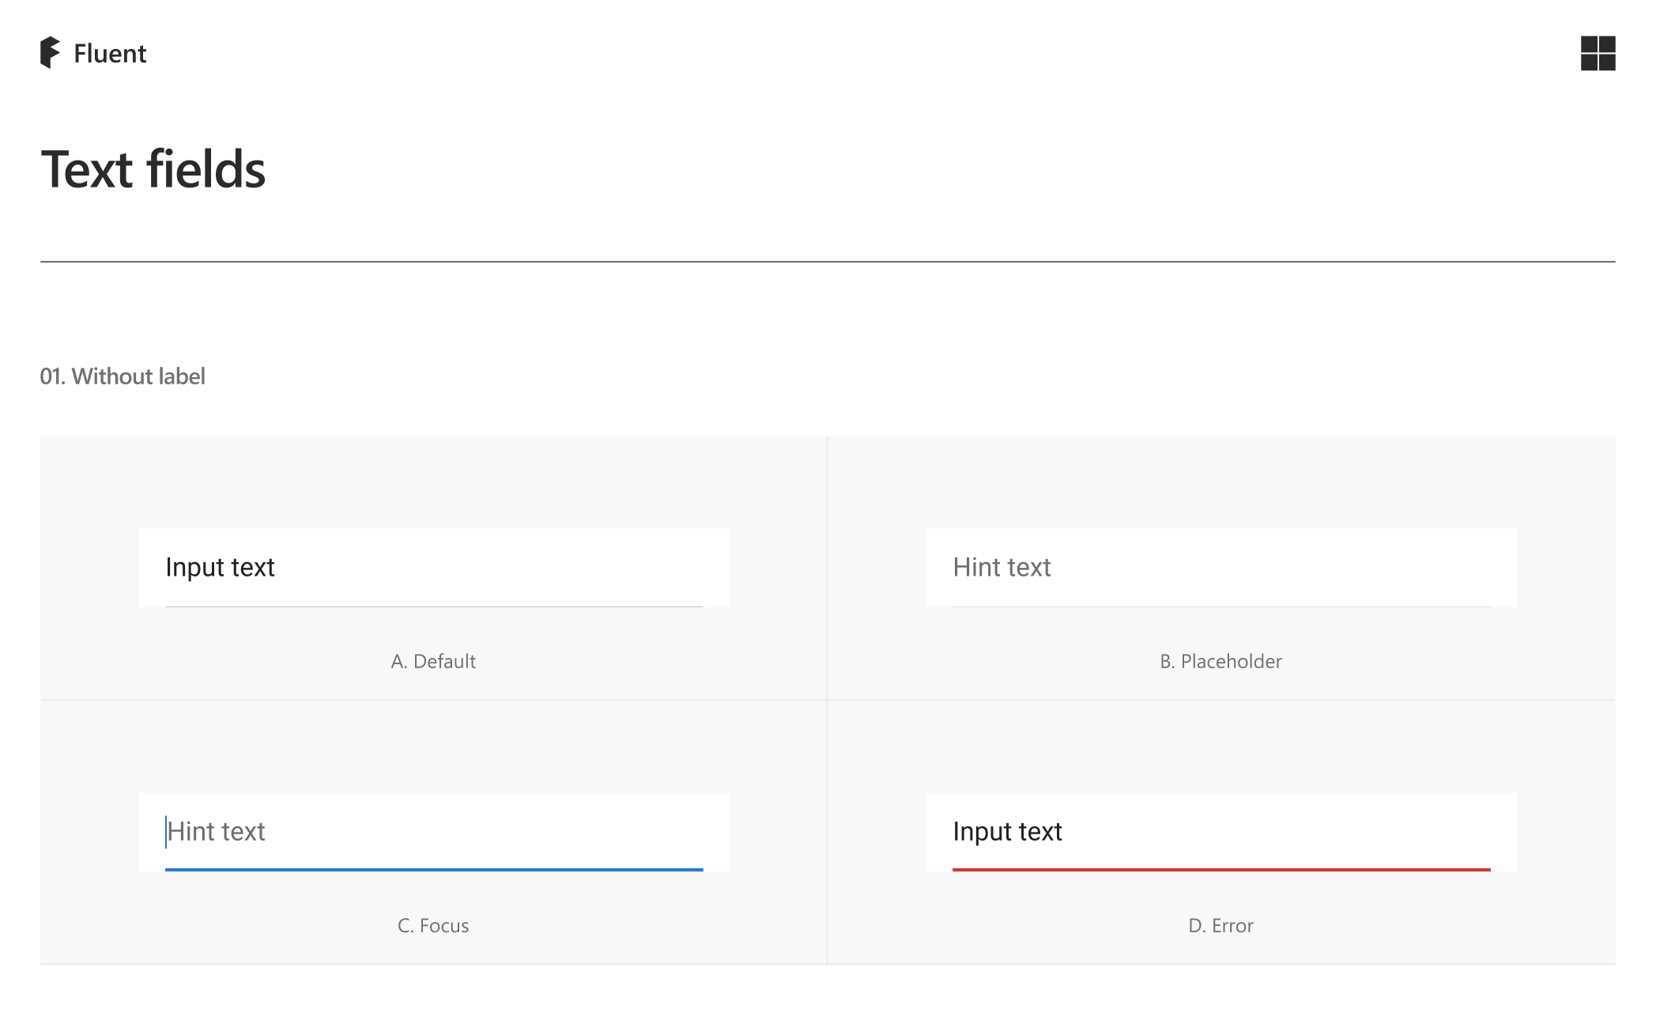
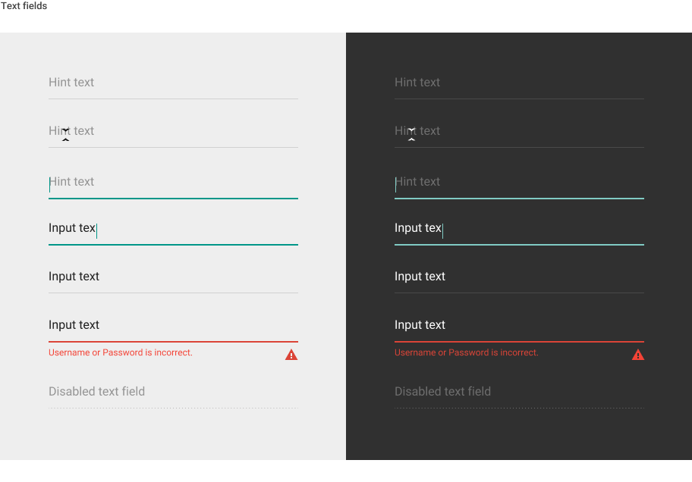
Visual Design
<Entry Visual=“Fluent” />
MATERIAL DESIGN

Slide 14
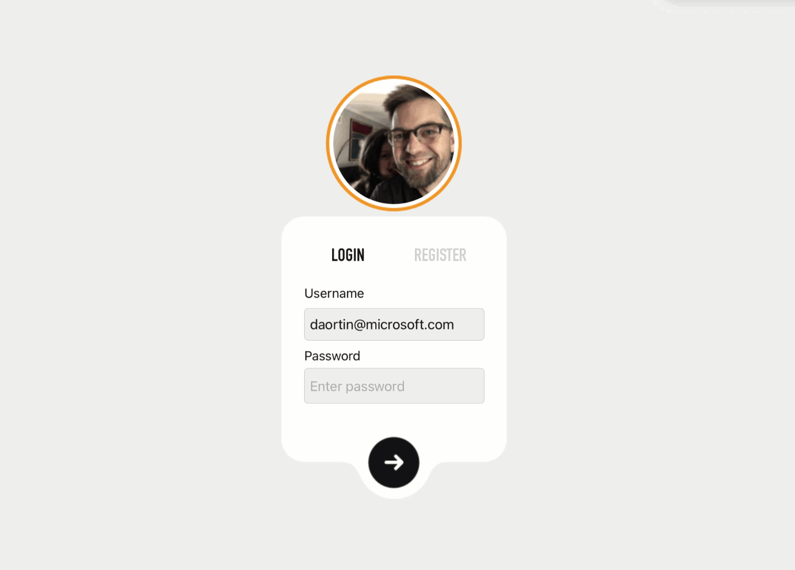
Platform Features
AppThemes (Dark Mode)
Accessibility
Adaptive Triggers
Brushes – Solid & Gradient
Clipping
Cross-platform Lifecycle
CSS & Styles
Databinding (Compiled, Multi, Relative)
Dual Screen Support
Essentials (Sensors, Permissions, Sharing, etc.)
FontImageSource
Gestures
MessagingCenter
Microsoft.Extensions.*
Multi-Window
Navigation – URI based
Right-to-Left
Visual State Manager
XAML

Slide 15






Component Vendors

Slide 16

Developer Experience

Slide 17
Demo
Familiar tools, familiar environment

Slide 18
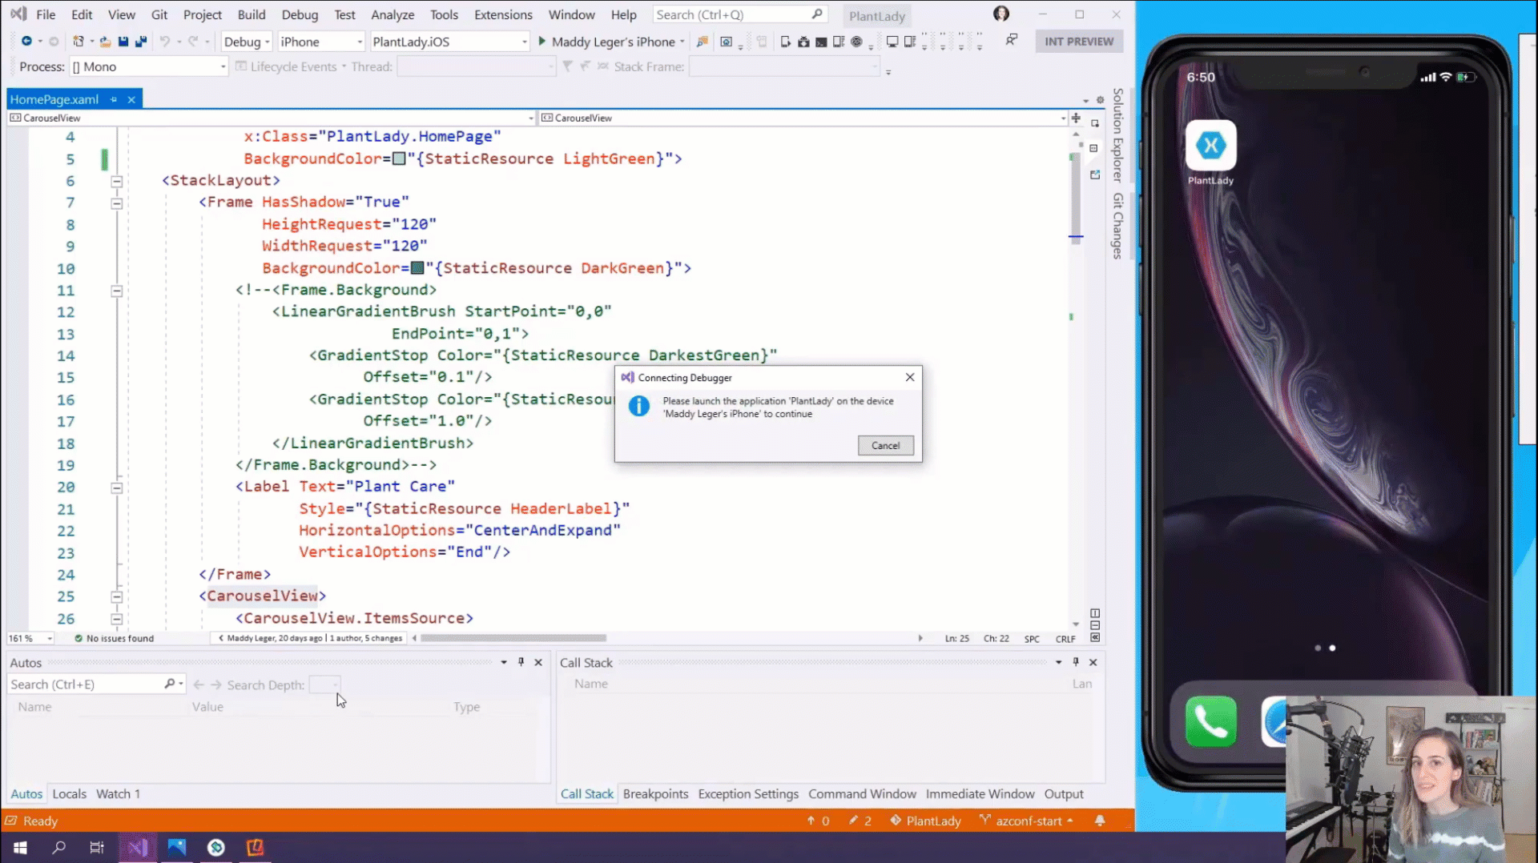

Slide 19
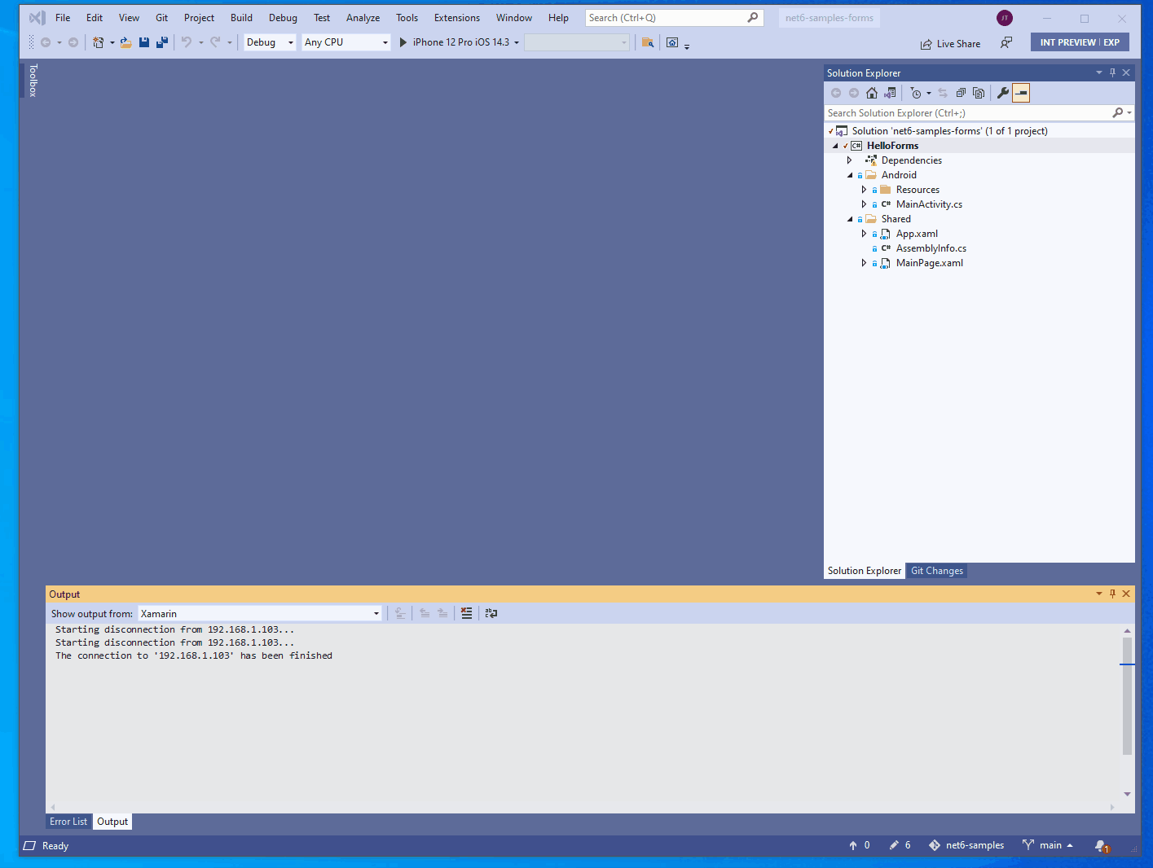
Simplified Cross-Platform Development
Single place for:
Images/Assets
App icons
Fonts
Launch screens
Manifest
Startup/App.cs
…and more!

Slide 20
Blazor hybrid desktop apps
Blazor
Reuse UI components across native and web
Built on top of .NET Multi-platform App UI
Native app container & embedded controls
General availability in .NET 6
Can use native app
container & controls
.NET Multi-platform App UI
macOS

Slide 21

Get Ready!
Timelines and how you can contribute

Slide 22
.NET 6 Timeline
Preview 1
Includes
Runtime and BCL, Mobile Workloads
Audience
Contributors
Preview 2
Includes
.NET MAUI views, layouts, everything that’s been merged
Android, iOS, macOS
Audience
Contributors

Slide 23
.NET 6 Timeline
Preview 3 & 4
Includes
.NET MAUI will have most controls, layouts, pages, and services
Adding WinUI 3
Audience
You!
What should you do with this release?
Build new apps and kick the tires
Open issues and join discussion on Discord

Slide 24
.NET 6 Timeline
Preview 5 – Release Candidate
Includes
.NET MAUI fills the remaining gaps, responds to feedback
Audience
Everyone!
What should you do with this release?
Build new apps and kick the tires
Migrate existing apps
Open issues and join discussion on Discord

Slide 25
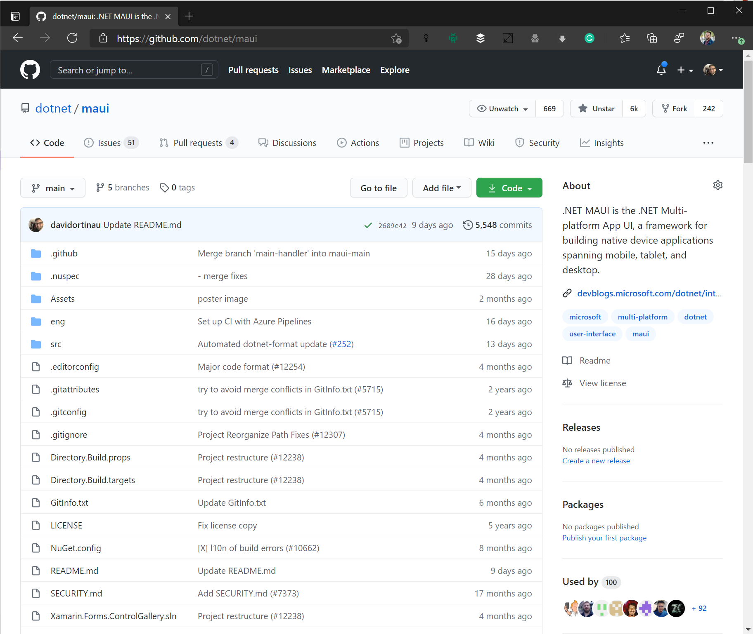
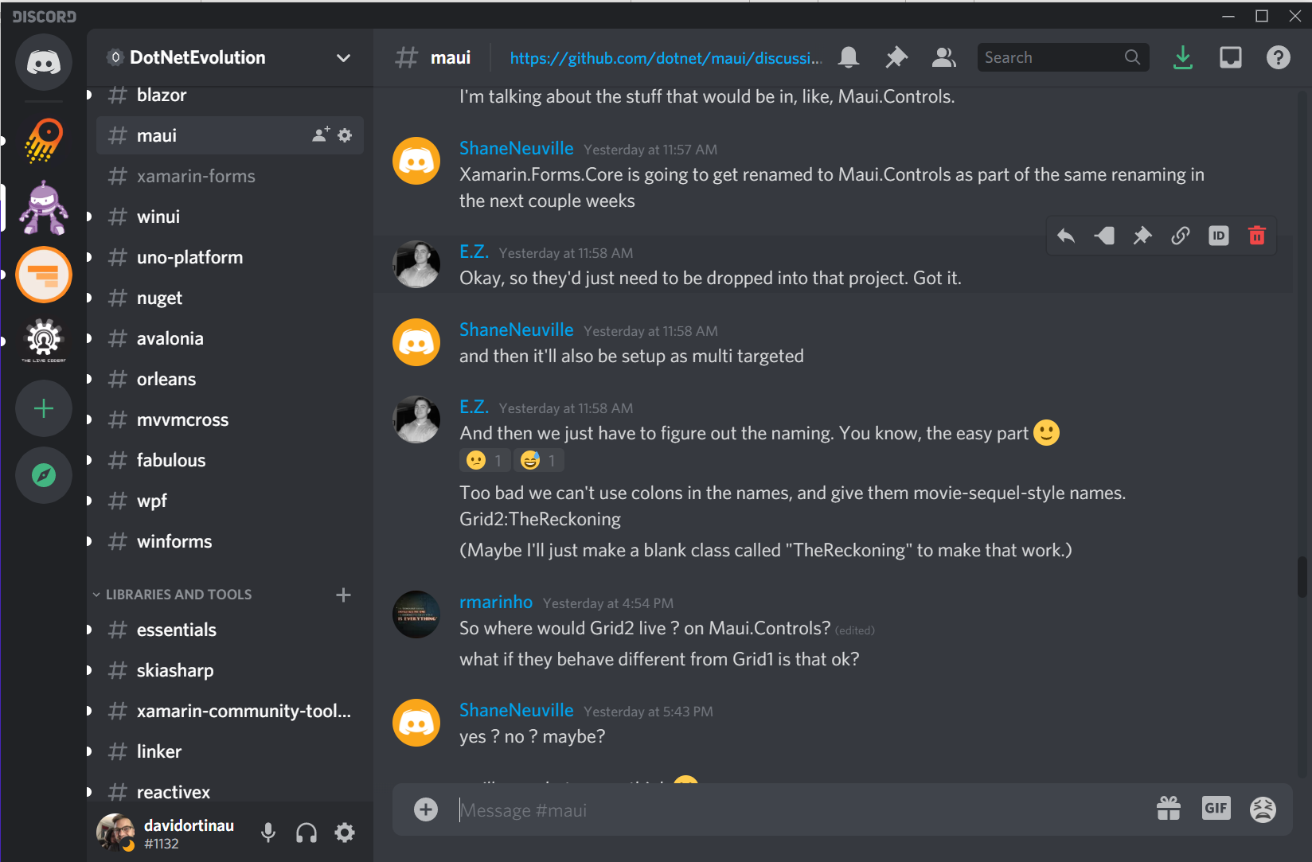
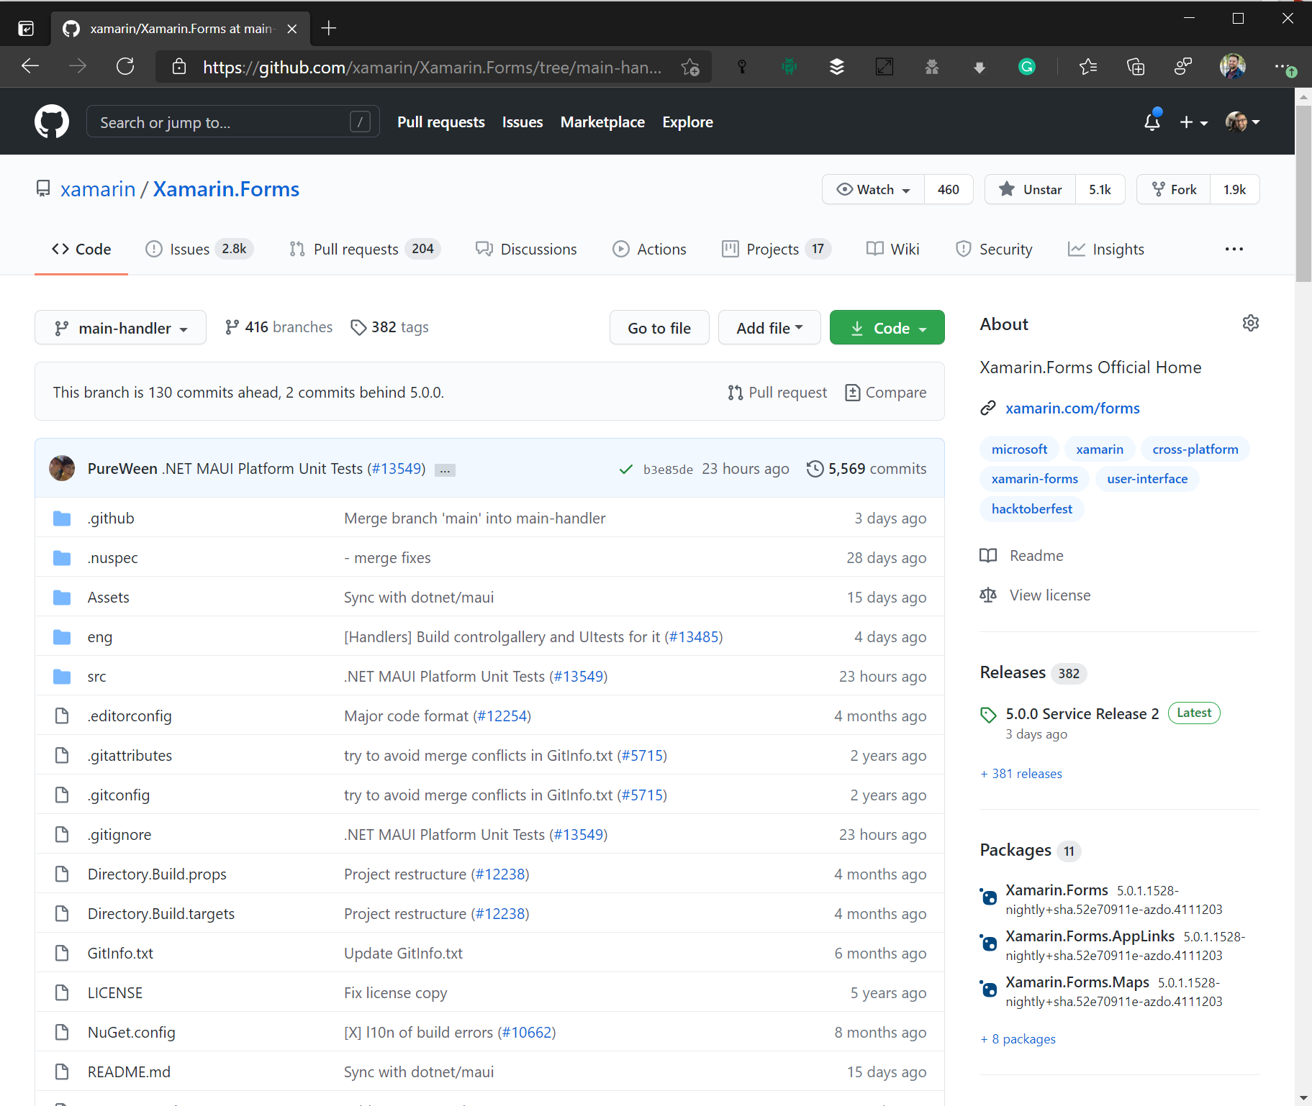
Where is this happening?
https://aka.ms/discord-maui
https://github.com/dotnet/maui

Slide 26
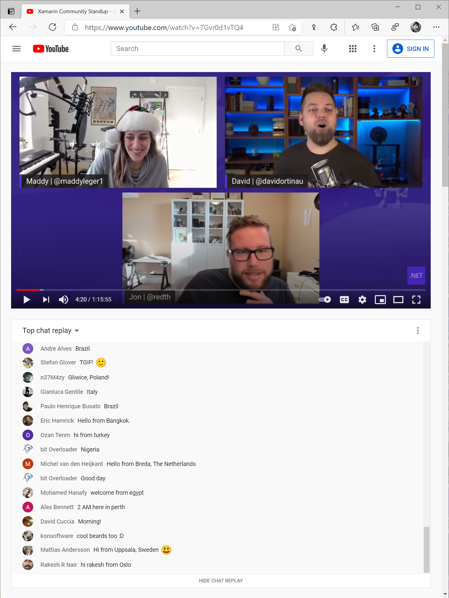
.NET Community Standup
https://live.dot.net
1st Thursday of the Month @ Noon PT / 3 ET
Community News
Contributions
.NET MAUI Status Report
Shenanigans!

Slide 27
OSS Library Maintainer - Monthly Sync
1st Tuesday of the Month @ Noon PT / 3 ET
Teams Call to deep dive on architecture and ask ?s
Current representation from:
FreshMvvm
Mobile Build Tools
MvvmCross
Prism
ReactiveUI
Shiny
Xamarin Community Toolkit
Uno Platform
To join:
📧 david.ortinau@microsoft.com

Slide 28
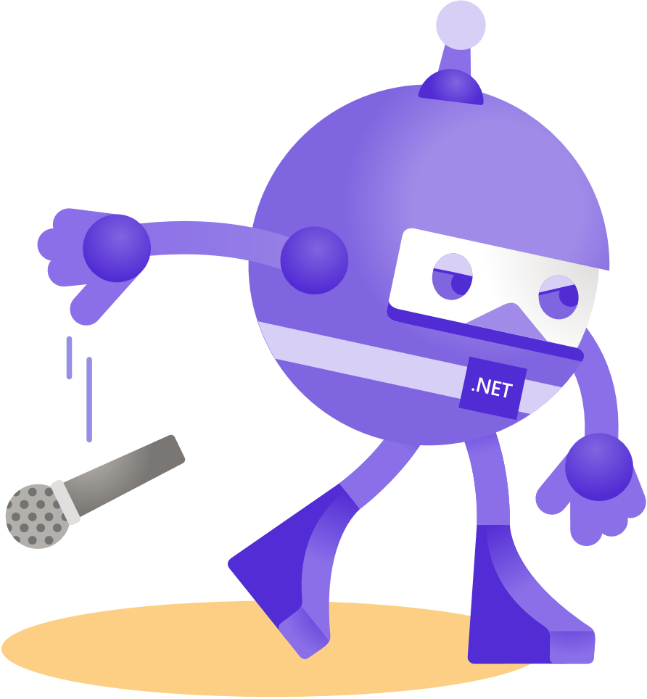
Thanks for joining!
David Ortinau | Program Manager | @davidortinau
Maddy Leger |Program Manager | @maddyleger1

